Slide 1
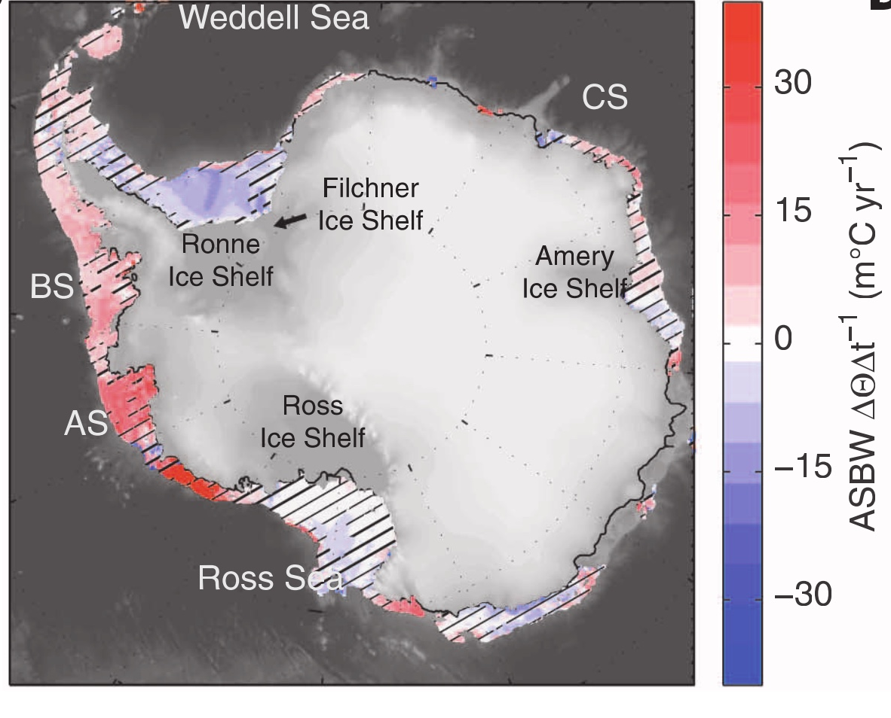

What controls the ocean temperature in West Antarctica? Will it continue warming?
Adele Morrison (with Andy Hogg, Matt England, Paul Spence)
1975-2012 trend in bottom temperature:
Schmidtko et al. 2014

Slide 2
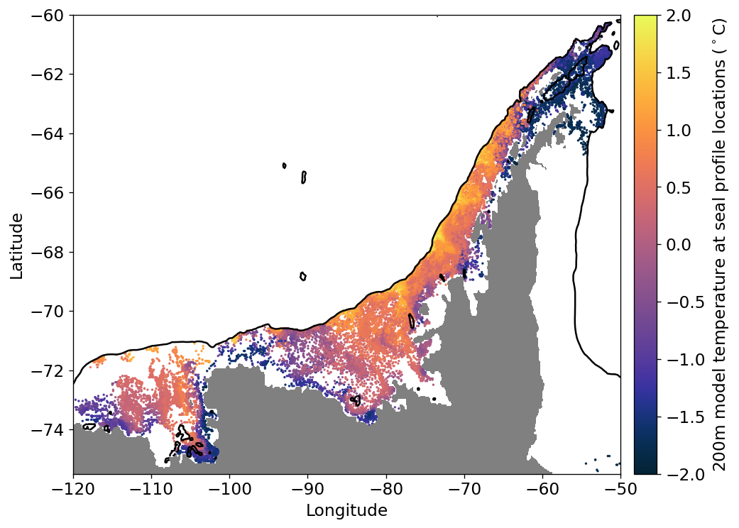
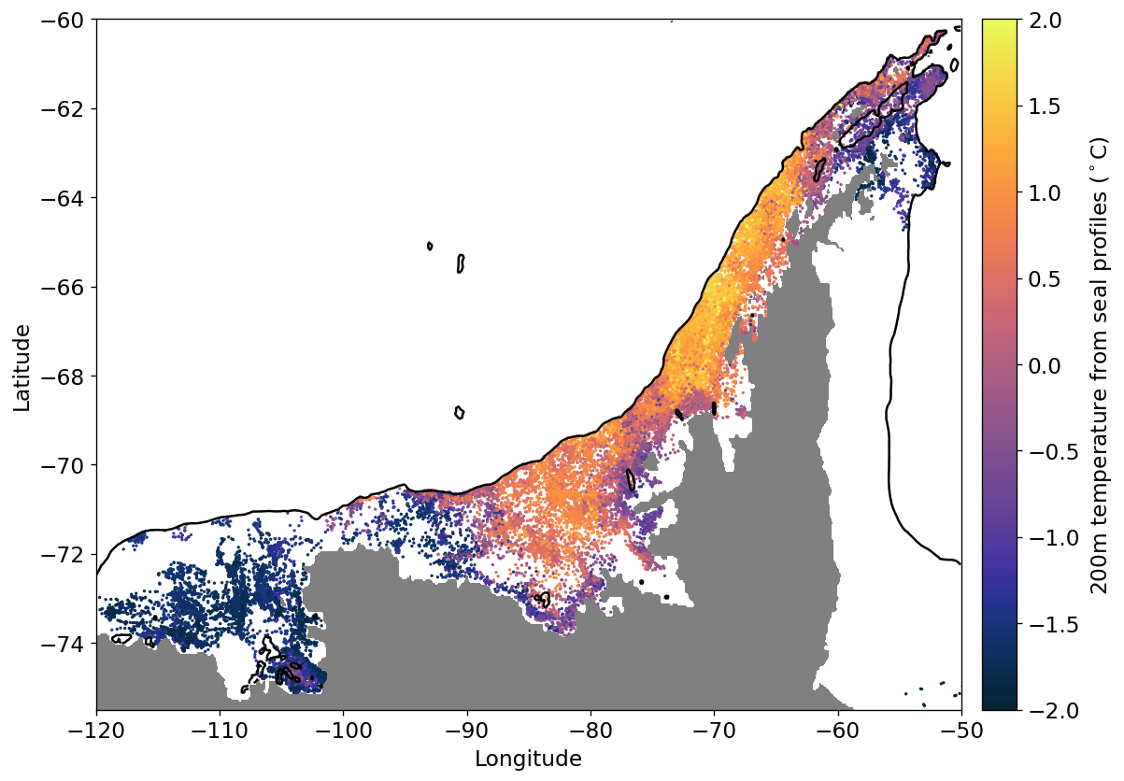
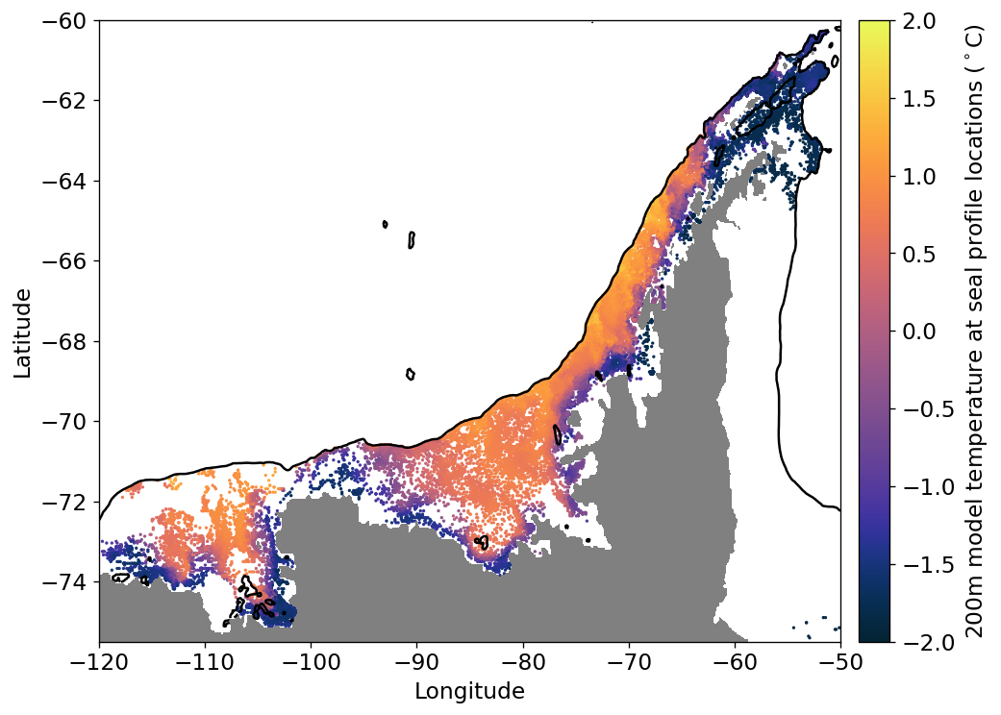
ACCESS-OM2-01, interannual-forced simulation temperature at 200 m:
Seal profile temperature at 200 m:

Slide 3
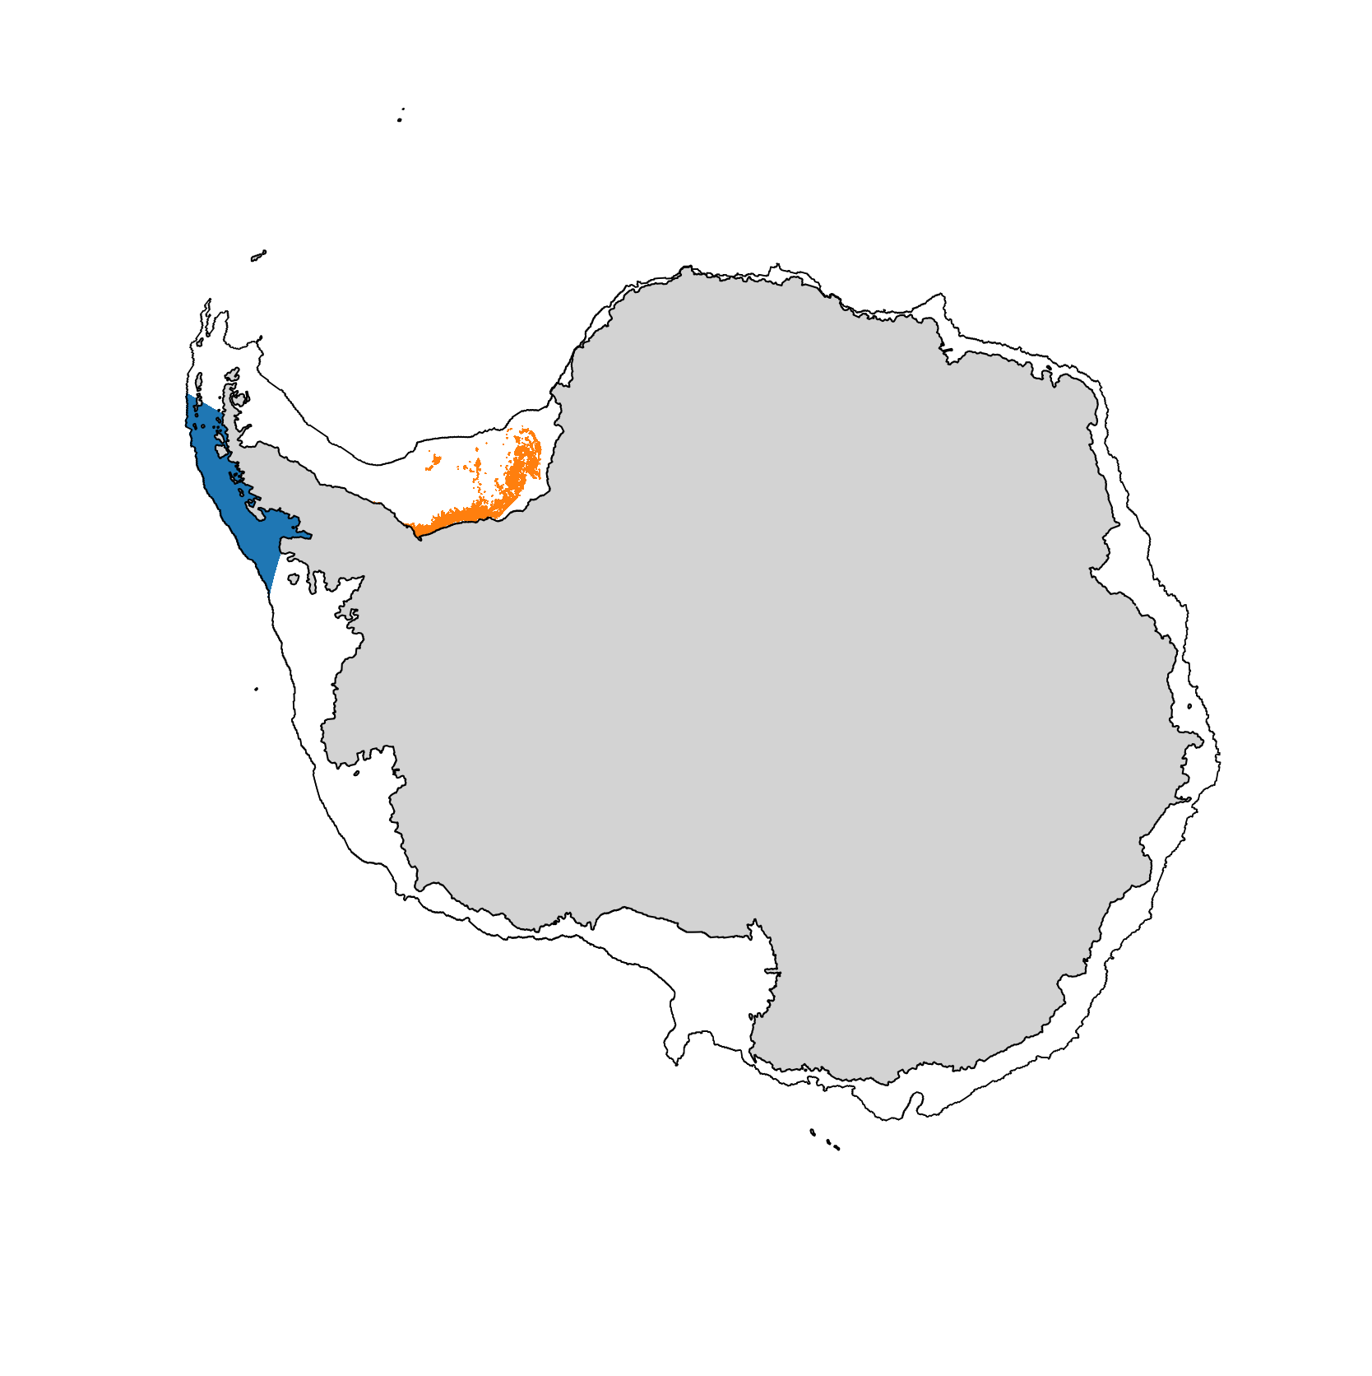
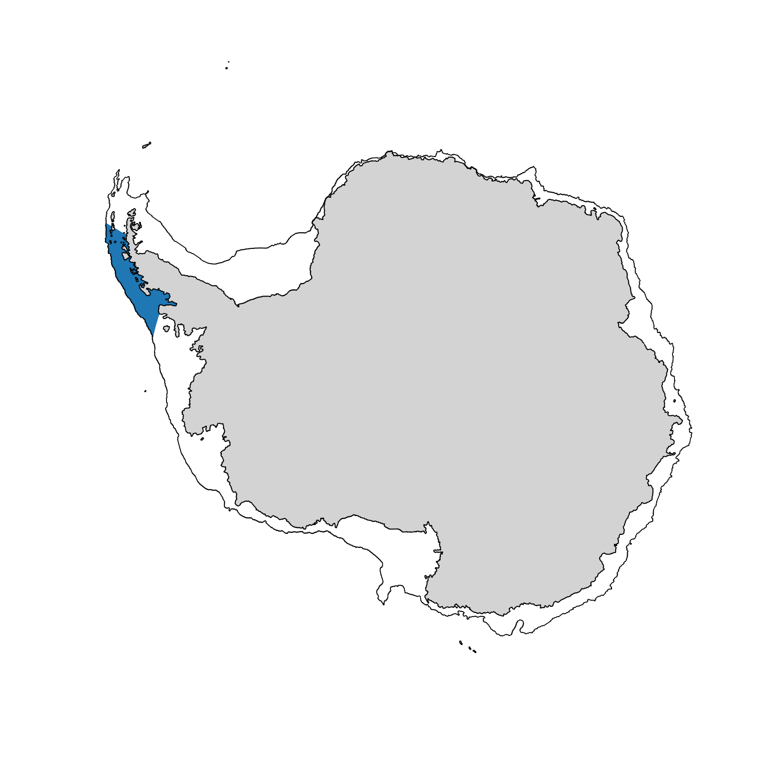
200m
temperature
ACCESS-OM2-01, IAF variability
dense water
formation

Slide 4
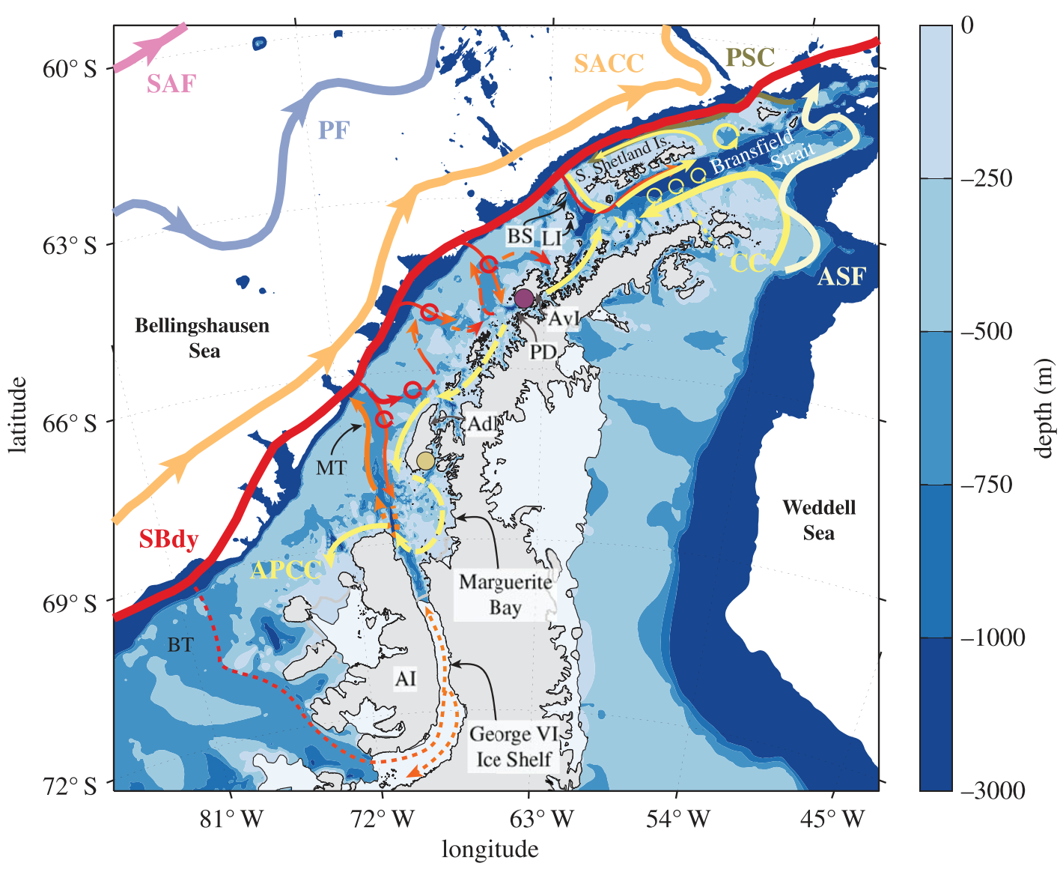
Moffat and Meredith 2018:
Observation summary schematic
Notes:
Still need to compare seal obs – temperature at 200m.

Slide 5
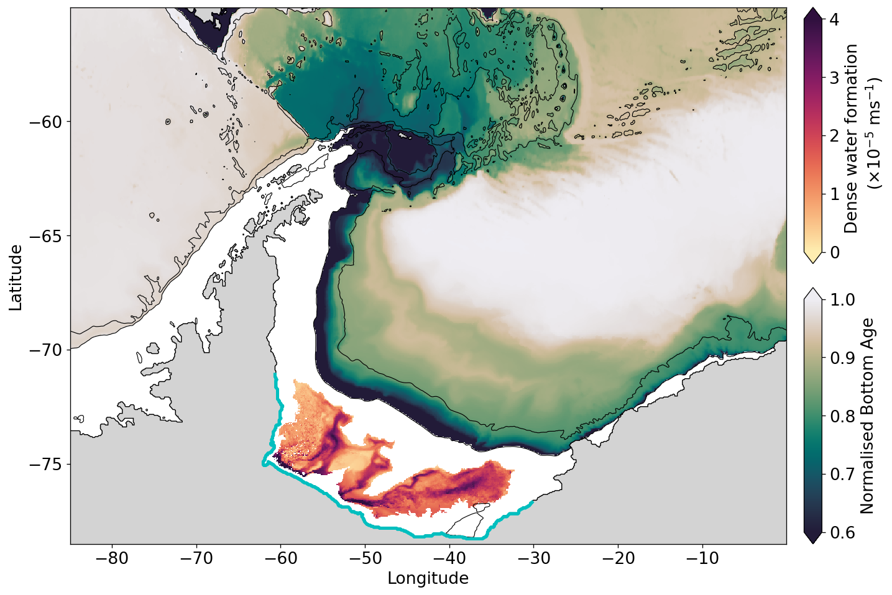
250 year spinup
Two 12 year Weddell freshwater perturbations:
ACCESS-OM2-01 Repeat Year Forced Simulation (RYF90-91)
0.5 x runoff
(‘Dense water increase’)
2 x runoff
(‘Dense water decrease’)
runoff altered

Slide 6
Weddell passive tracer anomaly after 12 years
Dense water increase
Dense water decrease

Slide 7
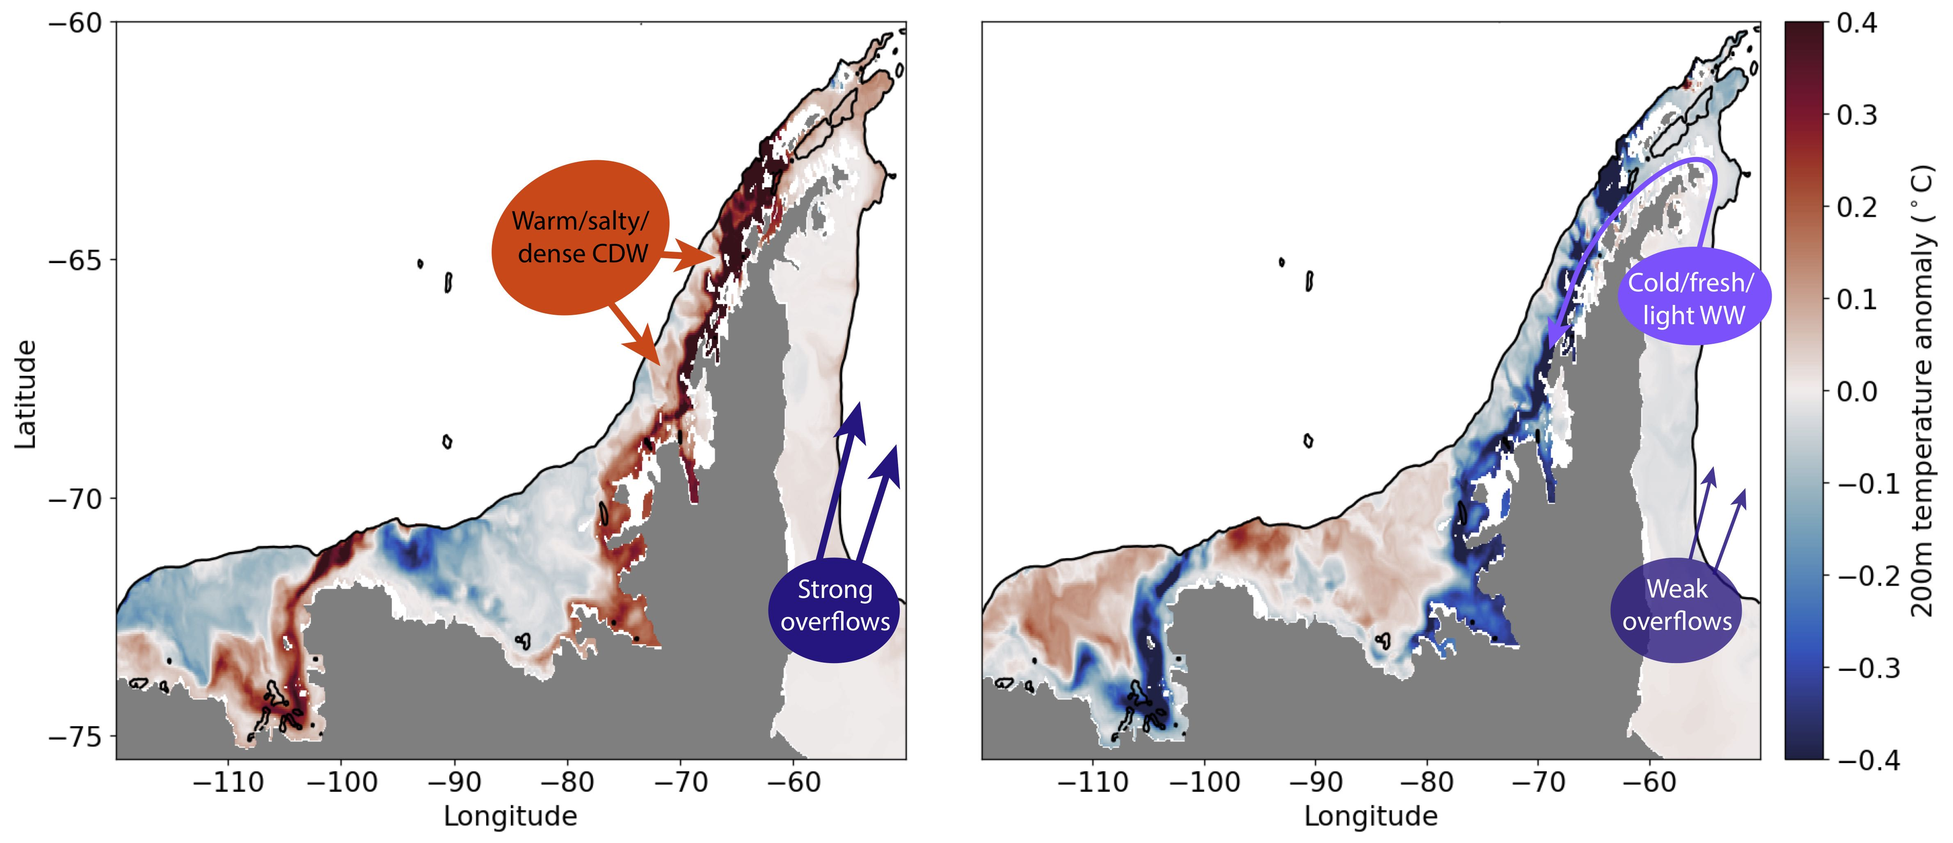
200m temperature anomaly in years 6-10:
Dense water increase
Dense water decrease
200m temperature anomaly averaged over West Antarctic Peninsula:

Slide 8
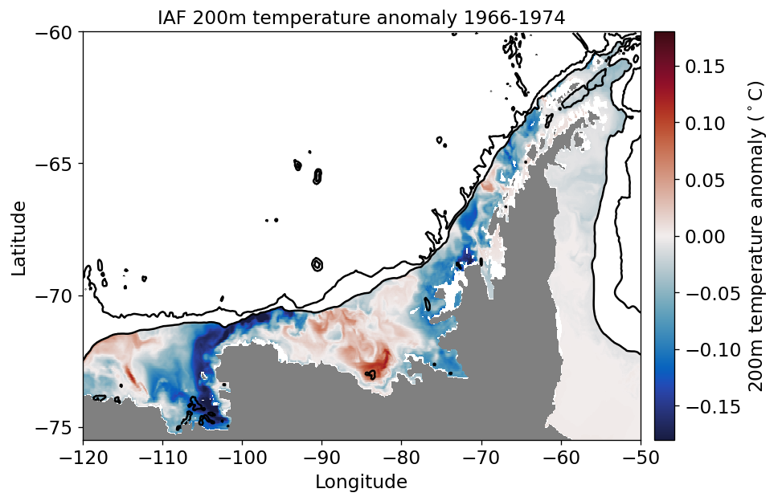
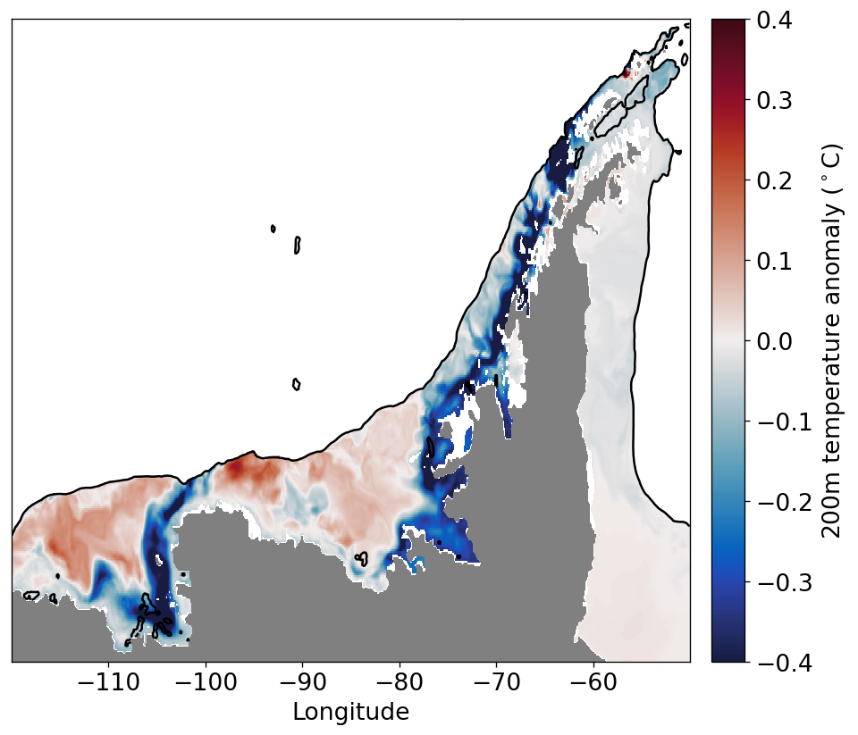
IAF: 1966-1974
RYF: Dense water decrease

Slide 9
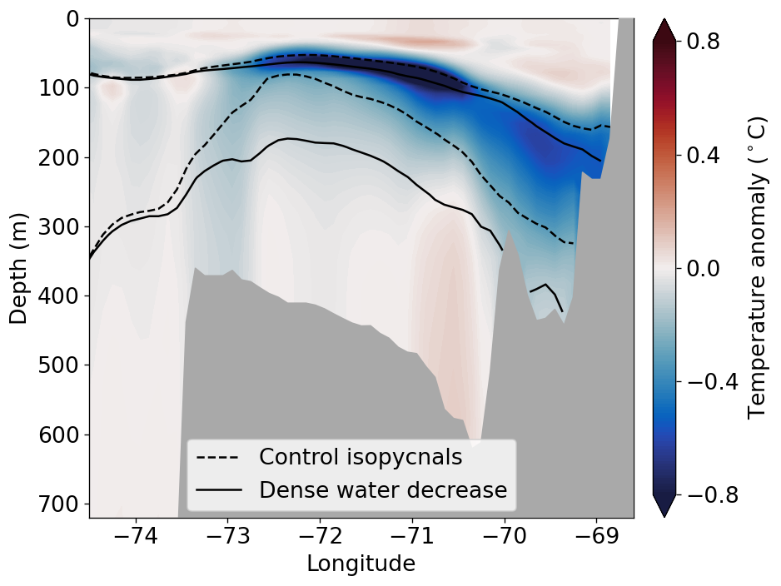
Temperature transect on West Antarctic Peninsula, years 6-10:
Antarctic Peninsula Coastal Current, at 67.3°S (12 month mean):

Slide 10
Conclusions:
Weddell dense water formation impacts West Antarctic variability.
If Weddell dense water slows down, the West Antarctic Peninsula may cool.
Dense water simulation impacts the temperature bias on the shelf downstream, as well as in the abyss.
Dense water increase
Dense water decrease

